Slide 1
Talks-with-Images
An Overview of Image Processing, Computer Vision, and Deep Learning

Slide 2
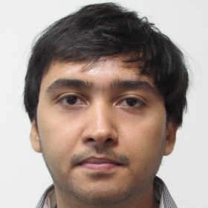
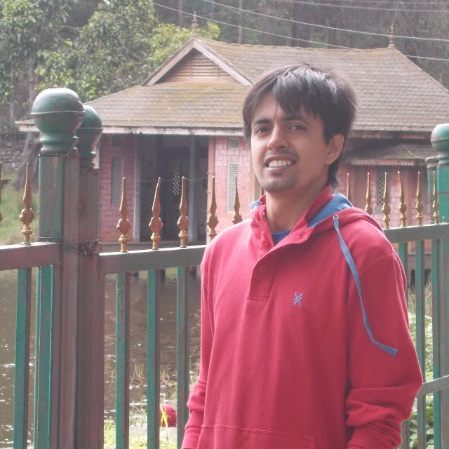
Speakers
Hello, I am Anuj Khandelwal,
currently working with Aditya Birla Group as a Data Scientist. I have more than 5 years of experience in building and deploying Computer Vision applications. In past, I have worked in the area of Smart Cities, Autonomous Vehicles and presently working in AI for Manufacturing.
Nitish is working with Accenture Labs, around 6 years of experience in AI Research and Innovation. Explored various Deep Learning frameworks for different industry use-cases around Image Classification, Semantic Segmentation, Style Transfer, Generative Adversarial Networks and 3D Object Modelling

Slide 3
Table of Content
Part I:
What are Images?
What is OpenCV?
Setting up OpenCV on a Linux machine.
What is Image Processing?
Image processing example: "blurring" in action
Core operations
Basic Operations on Images
Arithmetic operations on images
Image processing in OpenCV
Image Thresholding
Geometric Transformation of images
Image Gradients
Canny Edge Detection
Part II:
AI vs ML vs DL
Machine Learning Steps
Deep Learning
MNIST Example : Code
Image Classification
Feature Extraction
Convolution Neural Network
Object Detection
Object segmentation
Face Recognition
Style Transfer
Image Generation - GAN
Image Analytics
Links

Slide 4
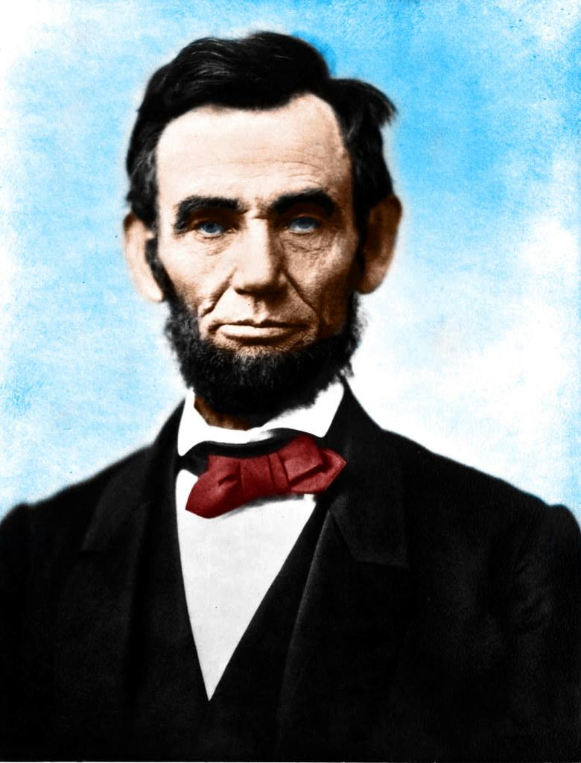
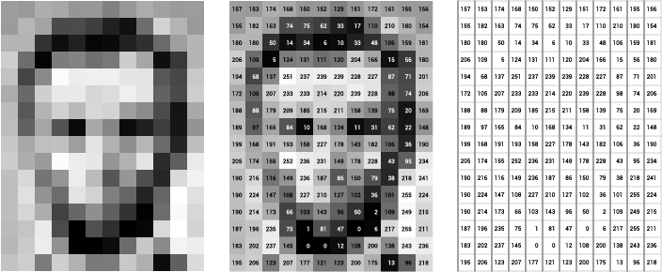
Images
What humans see
What a computer sees

Slide 5
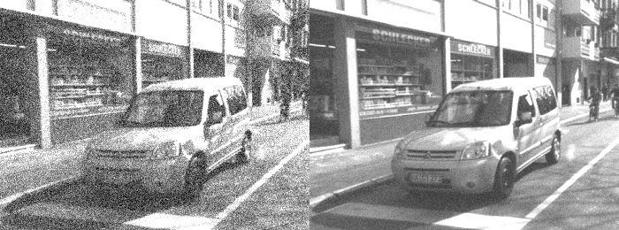
Image processing
Application: Removing noise from an image

Slide 6
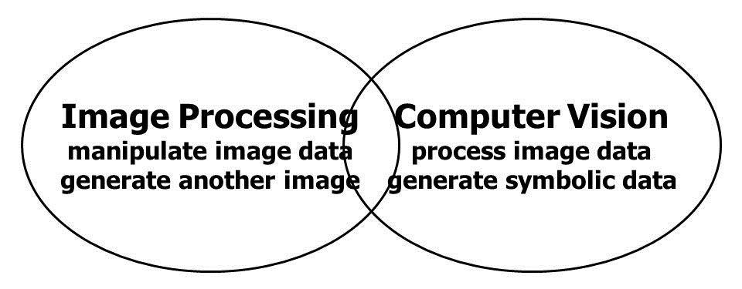
Image processing vs computer vision
Image processing: image in ->(some function) -> image out
Computer Vision: understanding the contents of an image

Slide 7


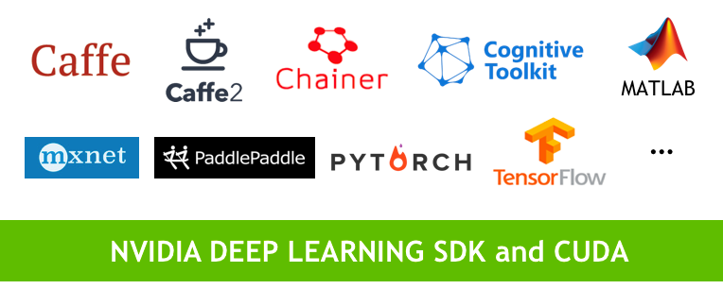


tools , library, framework

Slide 8

Let’s code...

Slide 9
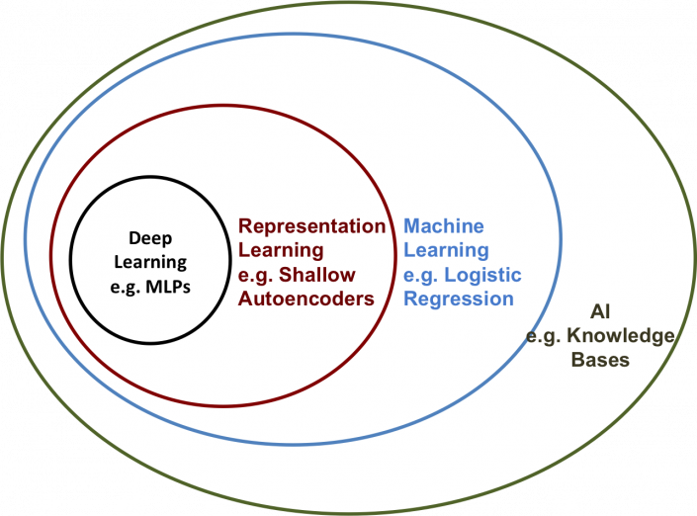

Ai vs Machine learning vs deep learning
AI (technique to enable machine to mimic humans) is super-set of ML
ML (program machines to learn and improve with experience) and ML is the super-set of DL.
DL (achieve great power and flexibility by learning to represent the data as nested hierarchy of concepts, i.e, more depth features with multiple processing layers, hence “deep”).

Slide 10

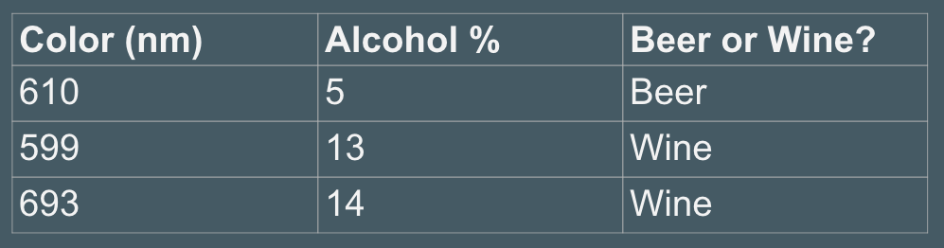
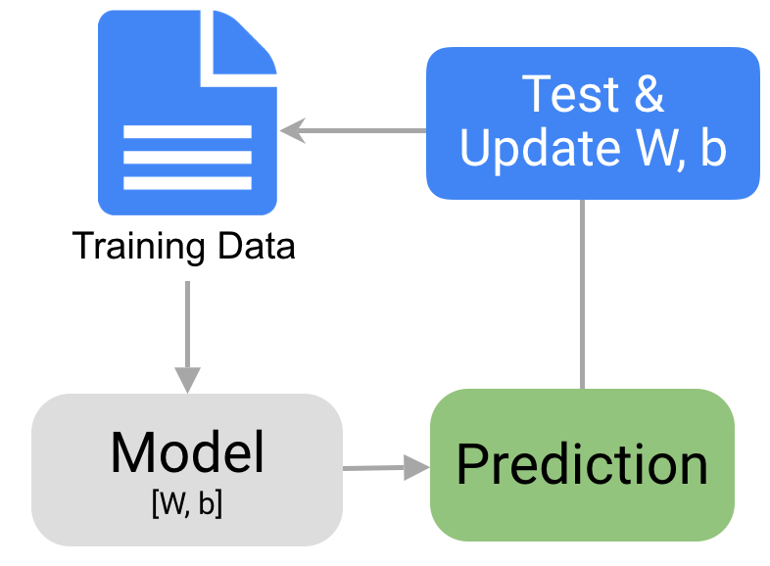
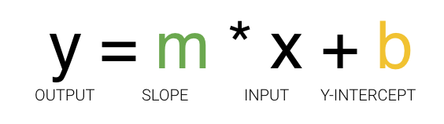
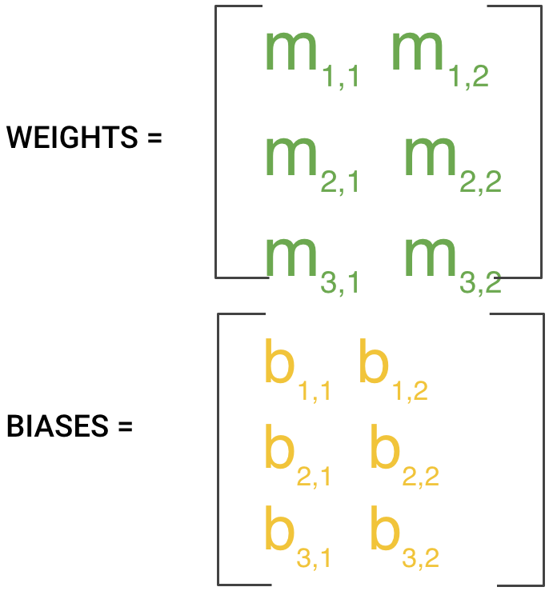
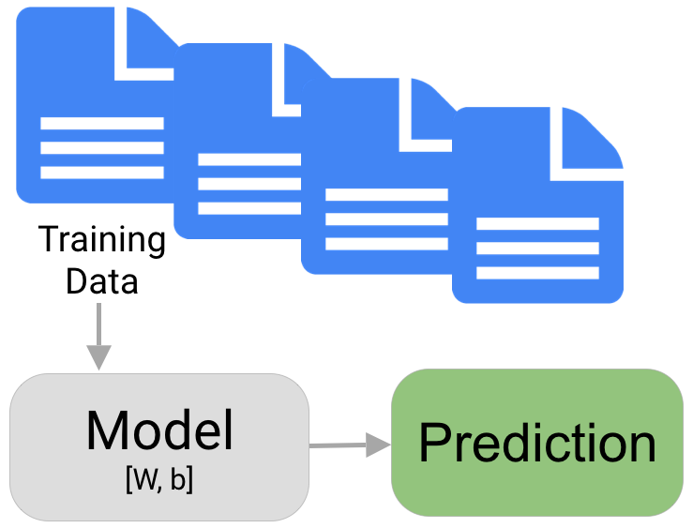
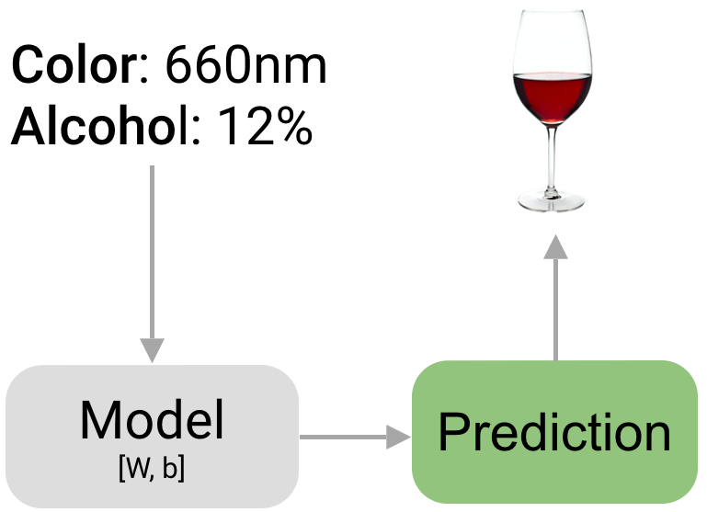
Machine learning in 7 steps
1
2
Problem Statement
Data Preparation
Choosing a model
Training
Evaluation / Validation
Hyperparameter tuning
Prediction/Testing
4
3
6
5
7

Slide 11

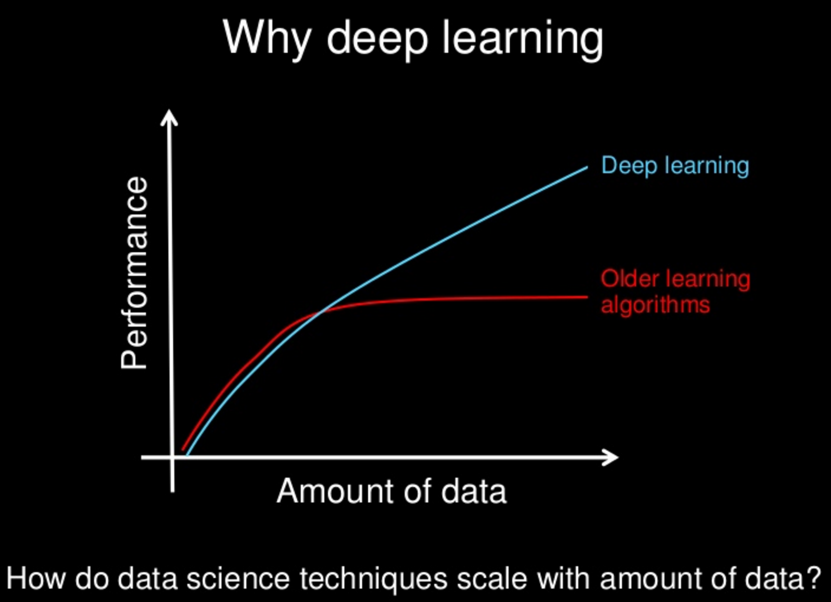
Deep Learning
Based on Concept on Artificial Neural Networks
“The hierarchy of concepts allows the computer to learn complicated concepts by building them out of simpler ones. If we draw a graph showing how these concepts are built on top of each other, the graph is deep, with many layers. For this reason, we call this approach to AI deep learning.” - Ian GoodFellow

Slide 12
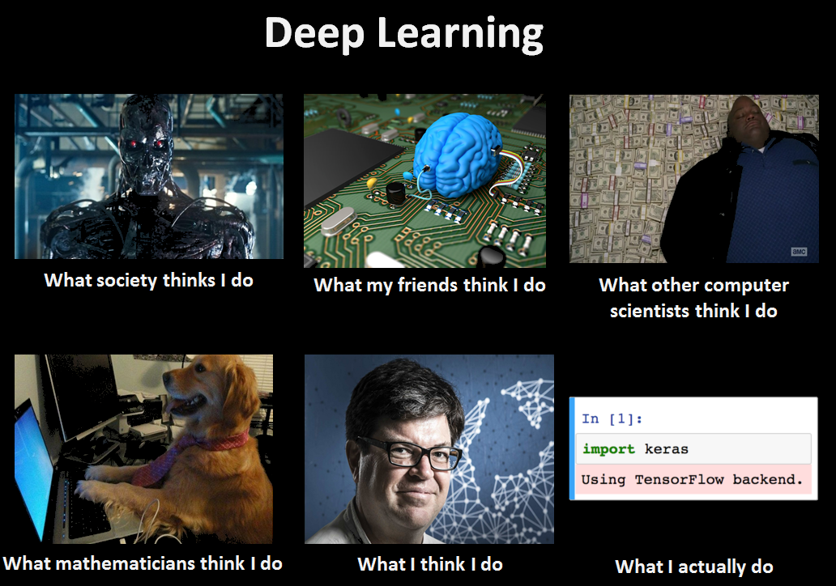
Let’s CODE

Slide 13

Deep learning with images

Slide 14
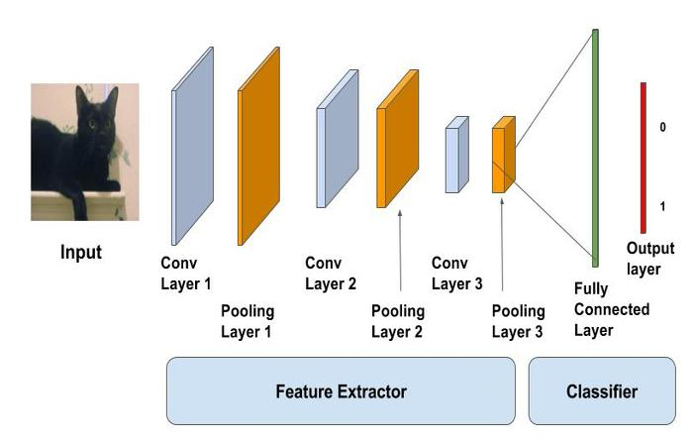
Image classification
Dataset
Images
Classes

Slide 15
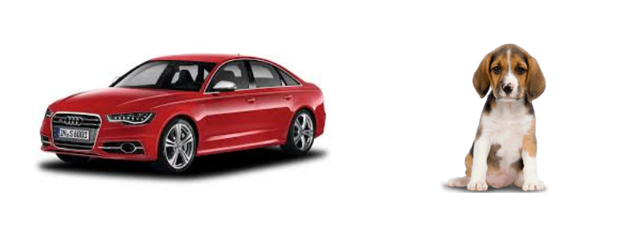
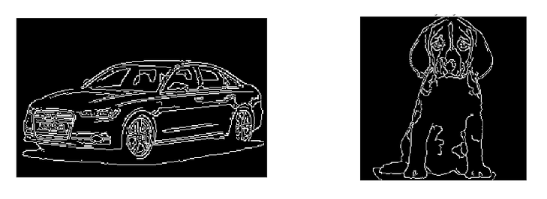
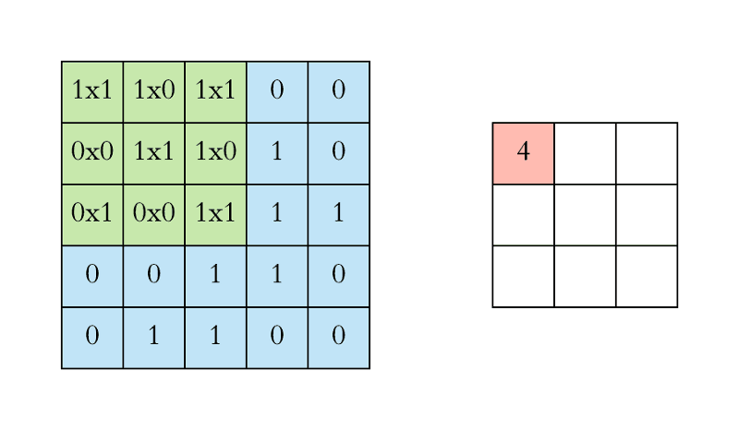
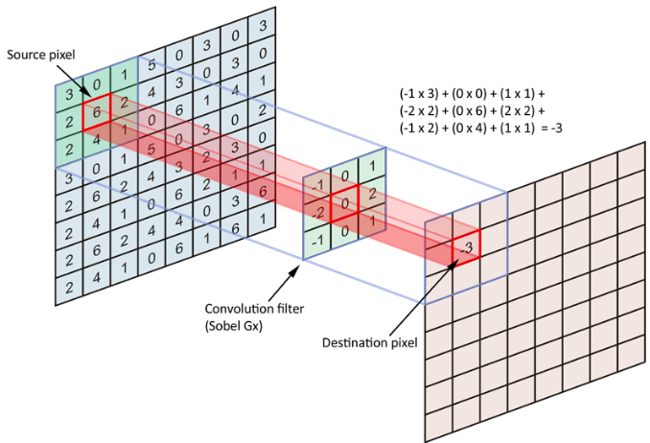
Feature extraction
HOG: Histogram of Oriented Gradients
SIFT: Scale Invariant Feature Transform
SURF: Speeded-Up Robust Feature
CNN: Convolution Neural Network

Slide 16

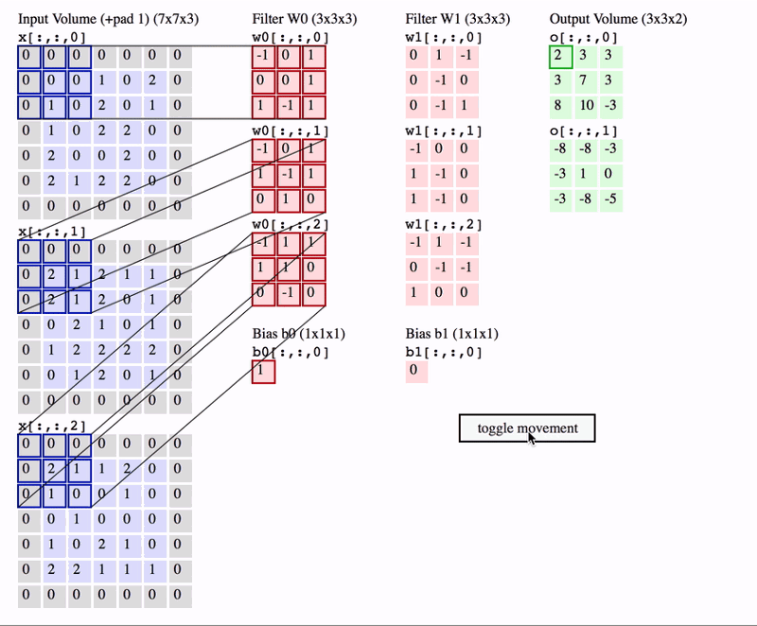
Convolution neural Network

Slide 17
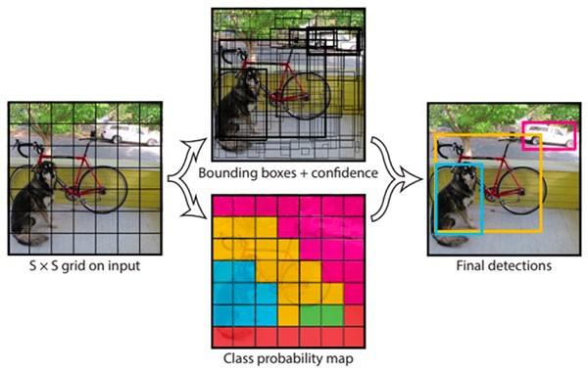
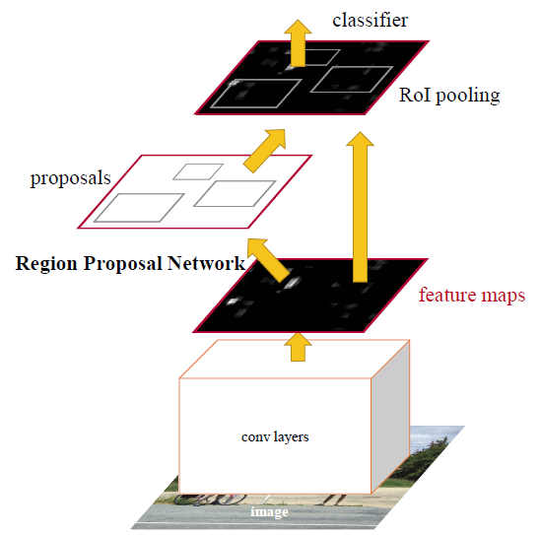
Object detection
Dataset
Images
Bounding Boxes(x,y,w,h)
Classes
Region Proposal Network, providing a number of regions which are then passed to common DL based classification architectures.
With the need of real time object detection, many one-step object detection architectures have been proposed, like YOLO, YOLOv2, YOLOv3, SSD, RetinaNet etc. which try to combine the detection and classification step.

Slide 18
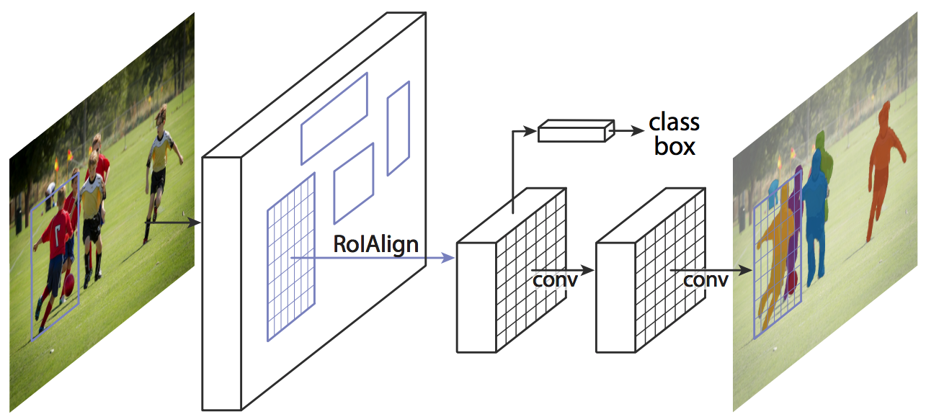
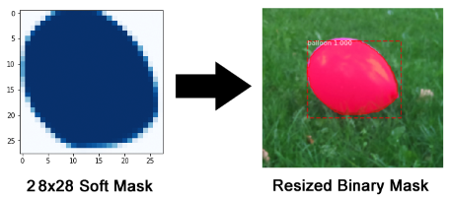
segmentation
Dataset
Images
Coordinates[list of (x,y)]
Classes
Segmentation Masks
The mask branch is CNN that takes the positive regions selected by the ROI classifier and generates masks for them.
The generated masks are low resolution: 28x28 pixels. But they are soft masks, represented by float numbers, so they hold more details than binary masks.

Slide 19

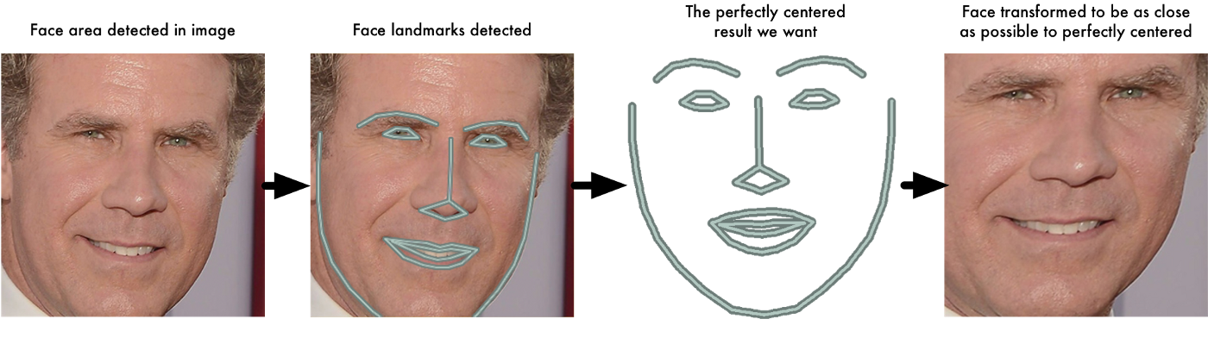
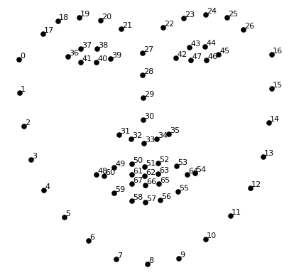
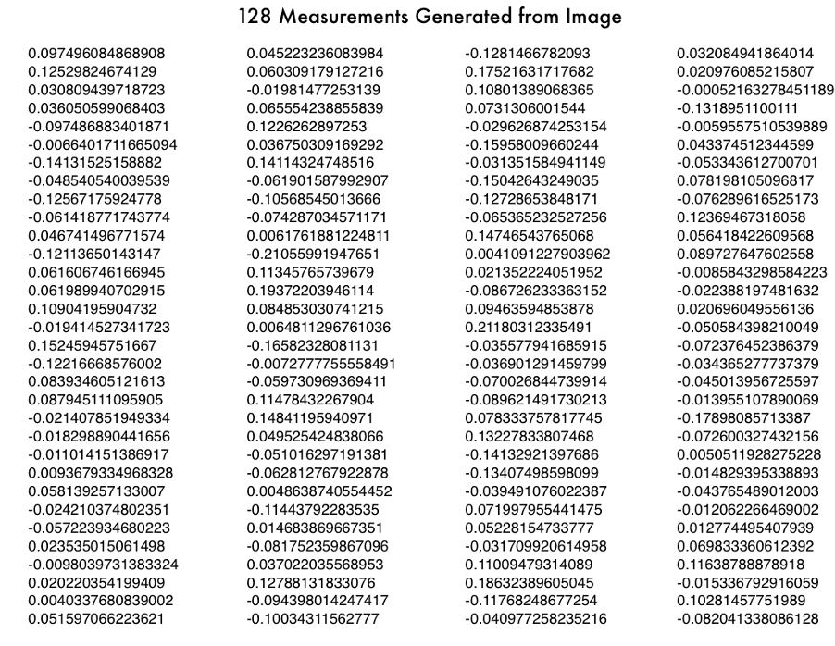
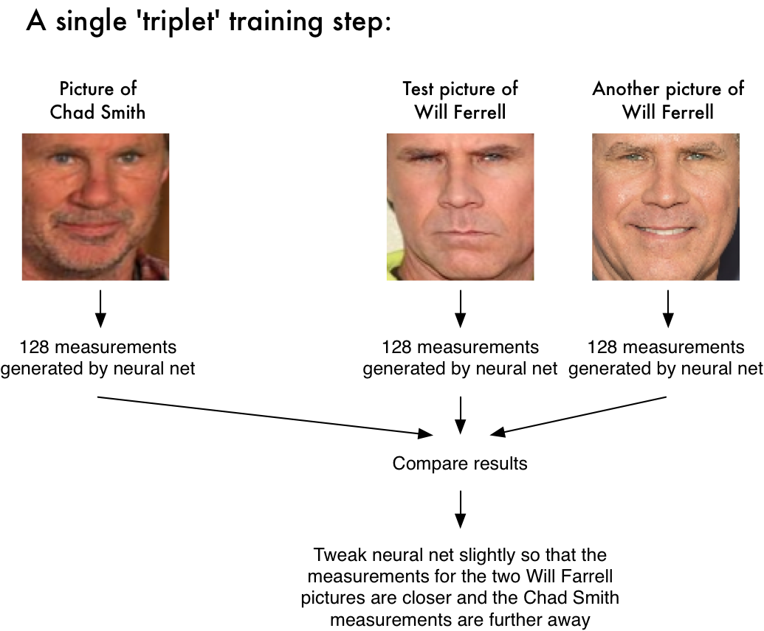
Face recognition
Dataset
Images
Classes
Algorithm:
Face Detection
Face Alignment
DeepNet Model to extract features
Pass the centered face image through a neural network that knows how to measure features of the face. Save those 128 measurements.
Testing new face : Extract 128 measurements and find the most similar match
Facebook automatically tags people in your photos that you have tagged before. I’m not sure if this is helpful or creepy! :P

Slide 20
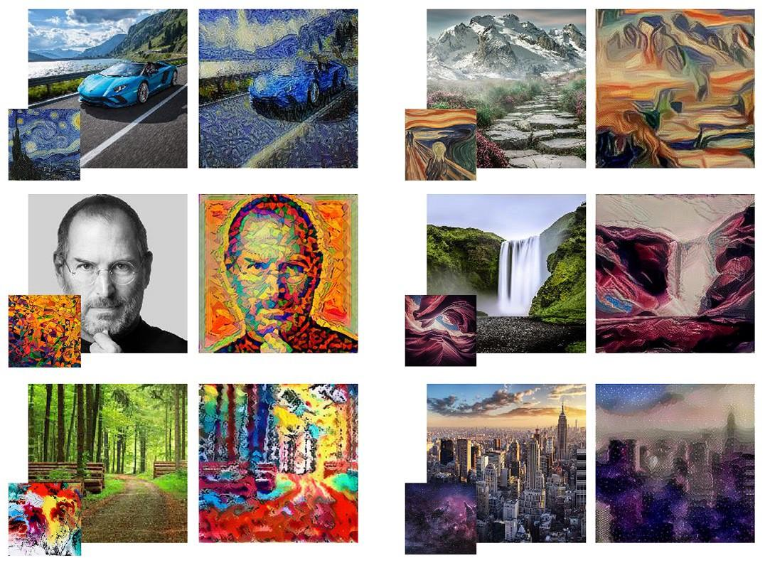
Style transfer
Problem Statement
Given:
Content Image
Style Image
Result:
Stylized Image
Algorithm
Feature Extraction of Content (A)
Feature Extraction of Style (B)
Merge Features(A+B)

Slide 21
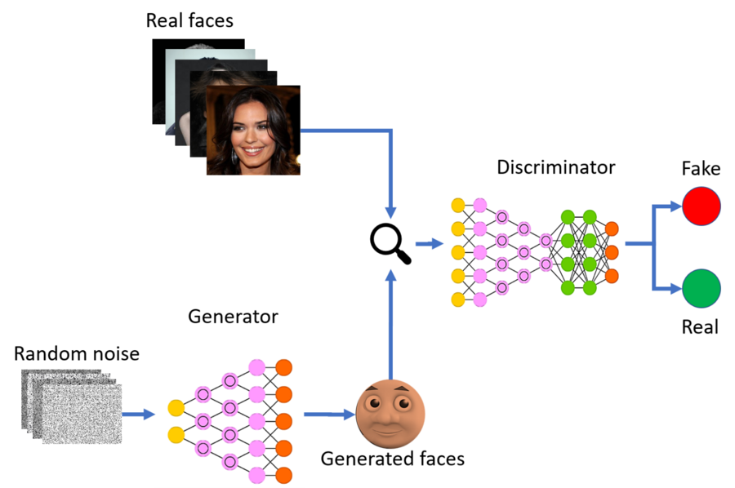
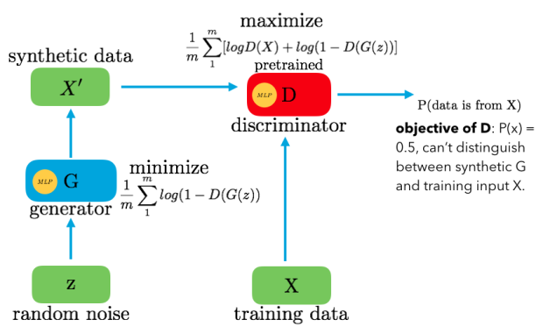
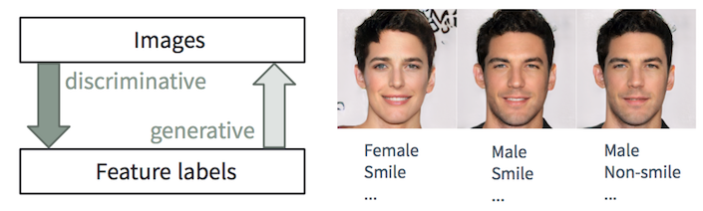
Image generation

Slide 22
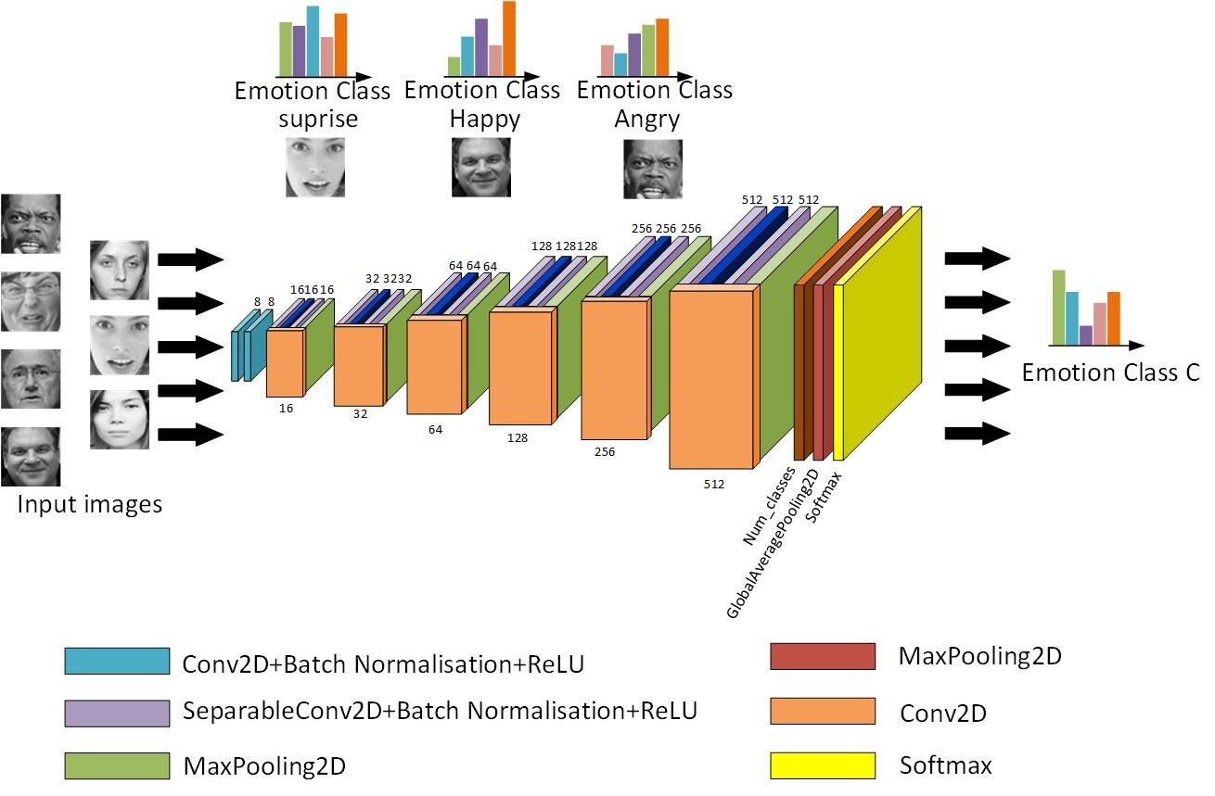
Image analytics
Problem Statement
Data Preparation
Choosing model(s)
Training
Evaluation / Validation
Hyperparameter tuning
Prediction/Testing
Combine Results
Presentation

Slide 23
Interesting Links
https://setosa.io/ev/image-kernels/
https://www.youtube.com/watch?v=nKW8Ndu7Mjw
https://towardsdatascience.com/gentle-dive-into-math-behind-convolutional-neural-networks-79a07dd44cf9
https://www.thispersondoesnotexist.com/
https://playground.tensorflow.org/
https://reiinakano.com/arbitrary-image-stylization-tfjs/
https://blog.insightdatascience.com/generating-custom-photo-realistic-faces-using-ai-d170b1b59255
https://engineering.matterport.com/splash-of-color-instance-segmentation-with-mask-r-cnn-and-tensorflow-7c761e238b46
https://github.com/ageitgey/face_recognition
https://medium.com/@manivannan_data/how-to-train-yolov2-to-detect-custom-objects-9010df784f36

Slide 24


